Slide 1

Business Intelligence: A Managerial Perspective on Analytics (3rd Edition)
Chapter 3:
Business Reporting,
Visual Analytics, and Business
Performance Management

Slide 2
Learning Objectives
Define business reporting and understand its historical evolution
Recognize the need for and the power of business reporting
Understand the importance of data/information visualization
Learn different types of visualization techniques
Appreciate the value that visual analytics brings to BI/BA
(Continued…)

Slide 3
Learning Objectives
Know the capabilities and limitations of dashboards
Describe the basic elements of balanced scorecards

Slide 4
Opening Vignette: Travel & Transport Inc.
Self-Service Reporting Environment Saves Millions For Corporate Customers
Background
Business Challenge
Solution
Results

Slide 5
Questions for the Opening Vignette
What does Travel and Transport, Inc., do?
Describe the complexity and the competitive nature of the business environment in which Travel and Transport, Inc., functions.
What were the main business challenges?
What was the solution? How was it implemented?
Why do you think a multi-vendor, multi-tool solution was implemented?
List and comment on three main benefits of the implemented system.

Slide 6
Business Reporting Definitions and Concepts
Report = Information → Decision
Report?
Any communication artifact prepared to convey specific information in a presentable form
A report can fulfill many functions
To ensure proper departmental functioning
To provide information
To provide the results of an analysis
To persuade others to act
To create an organizational memory…
Notes:
Can be created using Tableau.

Slide 7
What is a Business Report?
A written document that contains information regarding business matters.
Purpose: to improve managerial decisions
Source: data from inside and outside the organization (via the use of ETL)
Format: text + tables + graphs/charts
Distribution: in-print, email, portal/intranet
Data acquisition → Information generation → Decision making → Process management
Notes:
ETL: Extract, Transform, Load

Slide 8
Business Reporting

Slide 9
Key to Any Successful Report
Clarity …
Brevity …
Completeness …
Correctness …
Report types (in terms of content and format)
Informal – a single letter or a memo
Formal – 10-100 pages; cover + summary + text
Short report – periodic, informative, investigative

Slide 10
Types of Business Reports
Metric Management Reports
Help manage business performance through metrics
Service Level Agreements (SLAs) for externals
Key Performance Indicators (KPIs) for internals
Dashboard-Type Reports
Graphical presentation of several performance indicators in a single page using dials/gauges
Balanced Scorecard-Type Reports
Include financial, customer, business process, and learning & growth indicators
Notes:
Metric is a statistic that analyses performance.
SLA: if I used Microsoft’s servers, they should have a guarantee that it would only be down for a possible fixed number amount of hours per year. This should be specified in the contract.
KPI:

Slide 11
Components of Business Reporting Systems
Common characteristics
OLTP (online transaction processing)
ERP, POS, SCM, RFID, Sensors, Web, …
Data supply (volume, variety, velocity, …)
E(xtract)T(ransform)L(oad)
Data storage: choices from DW, Data Mart, Relational DB to spreadsheets
Business logic - how the recorded transactions/ events are to be converted into metrics, scorecards, and dashboards.
Publication medium - The system that builds the various reports and hosts them ( for users) or disseminates them ( to users). These systems may also provide notification, annotation, collaboration, and other services.
Assurance - determining if and when the right information is to be delivered to the right people in the right way/ format.
Notes:
ERP: Enterprise Resource Planning; it plans out every portion of a business or any other structure. It is implemented as one software package.
POS: Point of Sale
SCM: Supply Chain Management
RFID: Radio Frequency Identification
Data supply is the description of the data (metadata?)

Slide 12
Data and Information Visualization
“The use of visual representations to explore, make sense of, and communicate data.”
Data visualization vs. Information visualization
Information = aggregation, summarization, and contextualization of data
Related to information graphics, scientific visualization, and statistical graphics
Often includes charts, graphs, illustrations, …

Slide 13
A Brief History of Data Visualization
Data visualization can date back to the second century AD
Most developments have occurred in the last two and a half centuries
Until recently it was not recognized as a discipline
Today’s most popular visual forms date back a few centuries

Slide 14
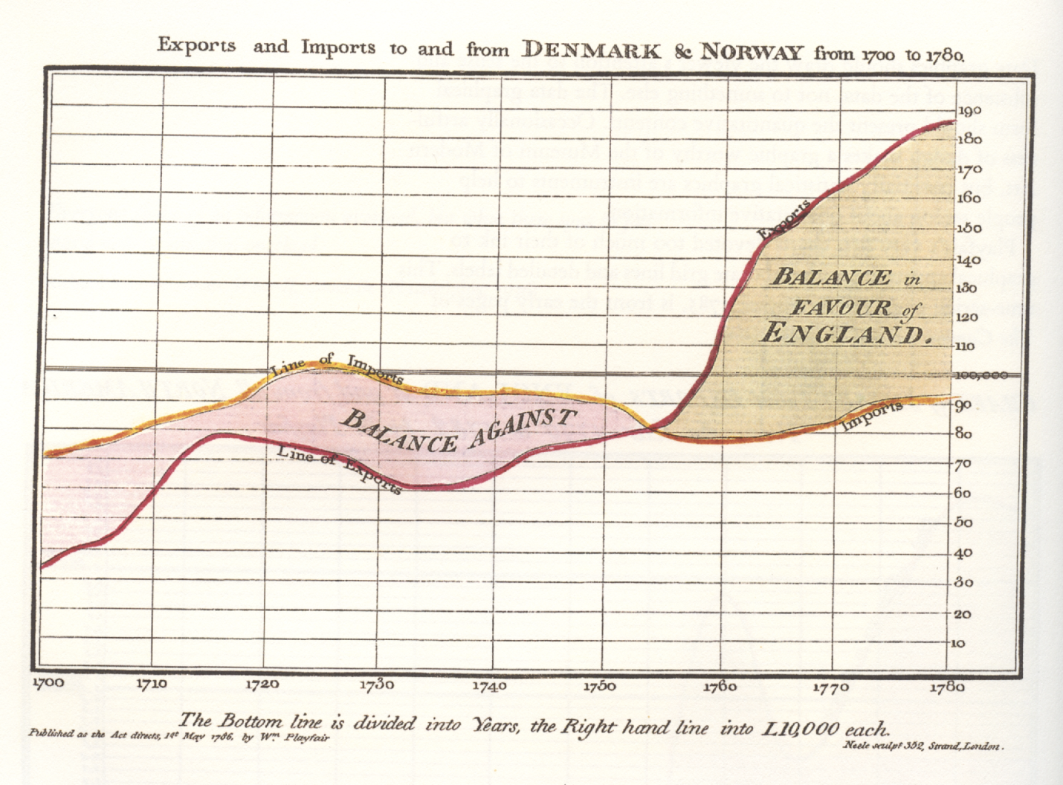
The First Pie Chart Created by William Playfair in 1801
William Playfair is widely credited as the inventor of the modern chart, having created the first line and pie charts.

Slide 15
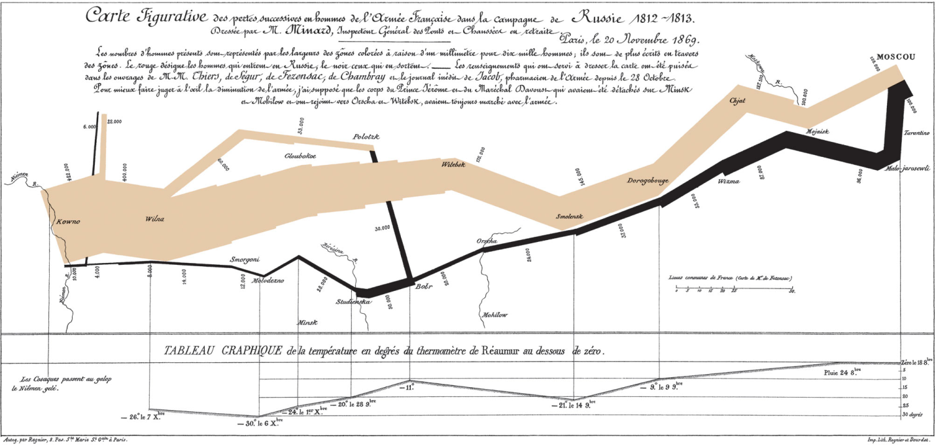
Decimation of Napoleon’s Army During the 1812 Russian Campaign
By Charles Joseph Minard
Arguably the most popular multi-dimensional chart

Slide 16
A Brief History of Data Visualization
1900s –
more formal attitude toward visualization
focus on color, value scales, and labeling
Publication of the book Semiologie Graphique
2000s –
Emergence of Internet as the medium for information visualization → raising visual literacy
Incorporate interaction, animation, 3D graphics-rendering, virtual worlds, real-time data feed
2010s and beyond – ?

Slide 17
Different Types of Charts and Graphs
Which one to use? Where and when?
Basic Charts and Graphs
Line Chart
Bar Chart
Pie Chart
Scatter Plot
Bubble Chart
Specialized Charts and Graphs
Histogram
Gantt Chart
PERT Chart
Geographic Map
Bullet Graph
Heat Map / Tree Map
Highlight Table

Slide 18
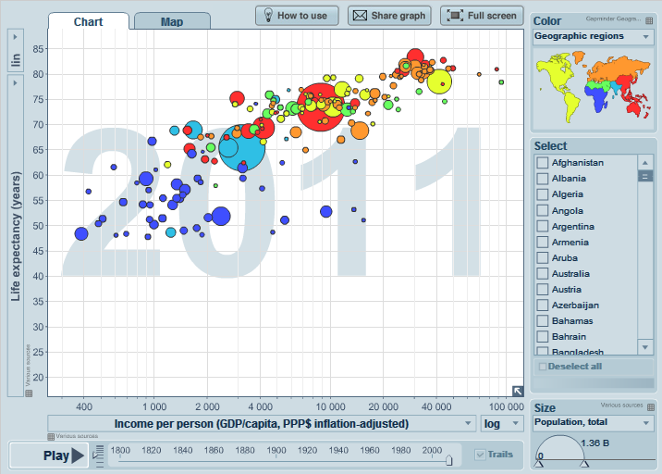
A Gapminder Chart Wealth and Health of Nations
See gapminder.org for
interesting animated examples

Slide 19
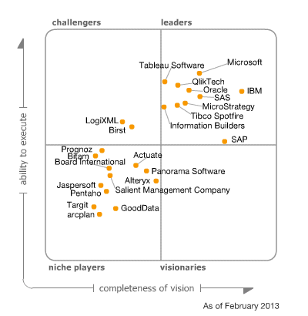
The Emergence of Data Visualization and Visual Analytics
Magic Quadrant for Business Intelligence and Analytics Platforms (Source: Gartner.com)
Many data visualization companies are in the 4th quadrant
There is a move toward visualization

Slide 20
The Emergence of Data Visualization and Visual Analytics
Emergence of new companies
Tableau, Spotfire, QlikView, …
Increased focus by the big players
MicroStrategy improved Visual Insight
SAP launched Visual Intelligence
SAS launched Visual Analytics
Microsoft bolstered PowerPivot with Power View
IBM launched Cognos Insight
Oracle acquired Endeca

Slide 21
Visual Analytics
A recently coined term
Information visualization + predictive analytics
Information visualization
Descriptive, backward focused
“what happened” “what is happening”
Predictive analytics
Predictive, future focused
“what will happen” “why will it happen”
There is a strong move toward visual analytics

Slide 22
Performance Dashboards
Performance dashboards are commonly used in BPM software suites and BI platforms
Dashboards provide visual displays of important information that is consolidated and arranged on a single screen so that information can be digested at a single glance and easily drilled in and further explored

Slide 23
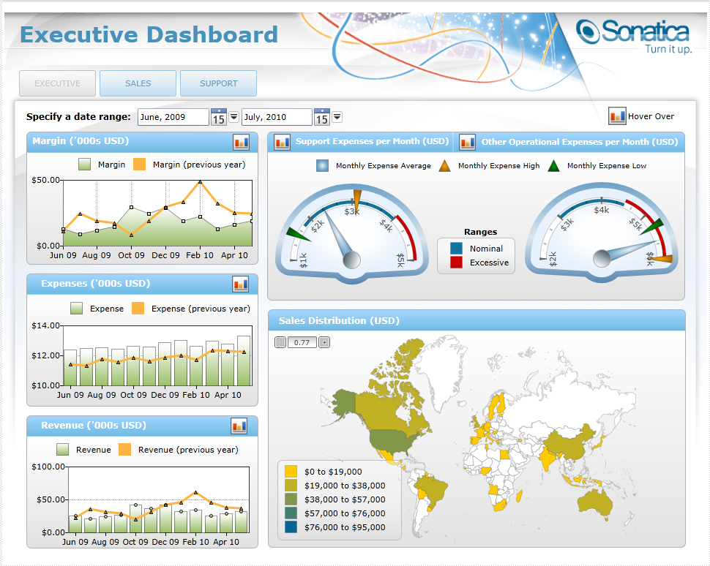
Performance Dashboards

Slide 24
Performance Dashboards
Dashboard design
The fundamental challenge of dashboard design is to display all the required information on a single screen, clearly and without distraction, in a manner that can be assimilated quickly
Three layers of information
Monitoring
Analysis
Management

Slide 25
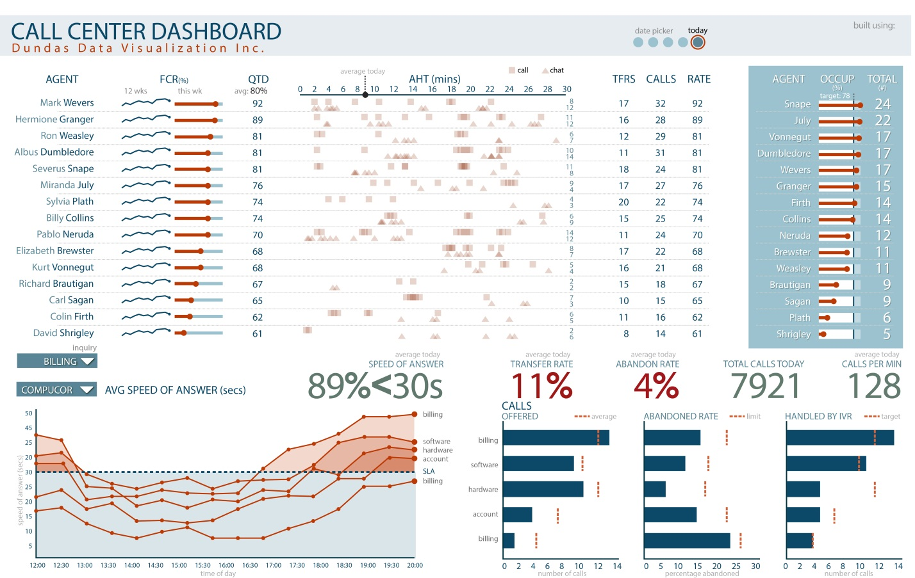
Application Case 3.6

Slide 26
Performance Dashboards
What to look for in a dashboard
Use of visual components to highlight data and exceptions that require action.
Transparent to the user, meaning that they require minimal training and are extremely easy to use
Combine data from a variety of systems into a single, summarized, unified view of the business
Enable drill-down or drill-through to underlying data sources or reports
Present a dynamic, real-world view with timely data
Require little coding to implement, deploy, and maintain

Slide 27
Best Practices in Dashboard Design
Benchmark KPIs with Industry Standards
Wrap the Metrics with Contextual Metadata
Validate the Design by a Usability Specialist
Prioritize and Rank Alerts and Exceptions
Enrich Dashboard with Business-User Comments
Present Information in Three Different Levels
Pick the Right Visual Constructs
Provide for Guided Analytics

Slide 28
KPIs and Operational Metrics
Key performance indicator (KPI)
A KPI represents a strategic objective and metrics that measure performance against a goal
Distinguishing features of KPIs
Strategy
Targets
Ranges
Encodings
Time frames
Benchmarks

Slide 29
Performance Measurement
Key performance indicator (KBI)
Outcome KPIs vs. Driver KPIs
(lagging indicators (leading indicators
e.g., revenues) e.g., sales leads)
Operational areas covered by driver KPIs
Customer performance
Service performance
Sales operations
Sales plan/forecast

Slide 30
Performance Measurement System
Balanced Scorecard (BSC)
A performance measurement and management methodology that helps translate an organization’s financial, customer, internal process, and learning and growth objectives and targets into a set of actionable initiatives
"The Balanced Scorecard: Measures That Drive Performance” (HBR, 1992)

Slide 31
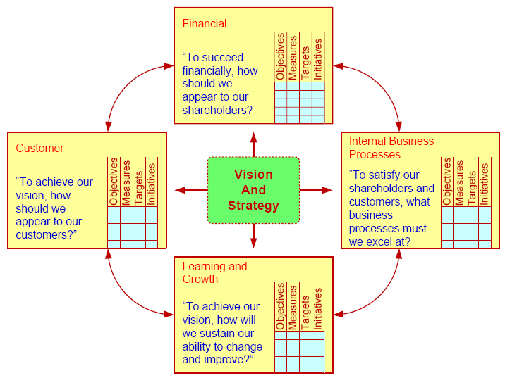
Balanced Scorecard
The meaning of “balance” ?

